Slide 1


Are these emotions familiar?
Panic
Stress

Slide 2

Project Question
How can an organizational application improve a student’s time management skills?

Slide 3
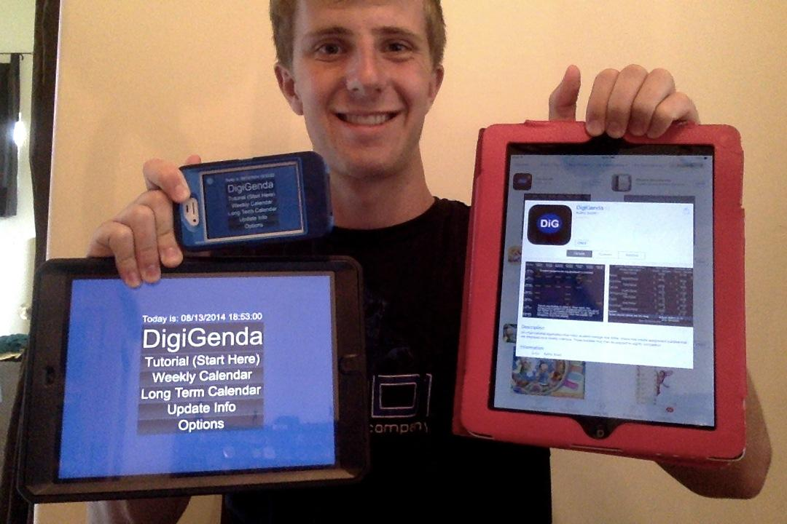
Develop an iOS Application
Jon Scott

Slide 4
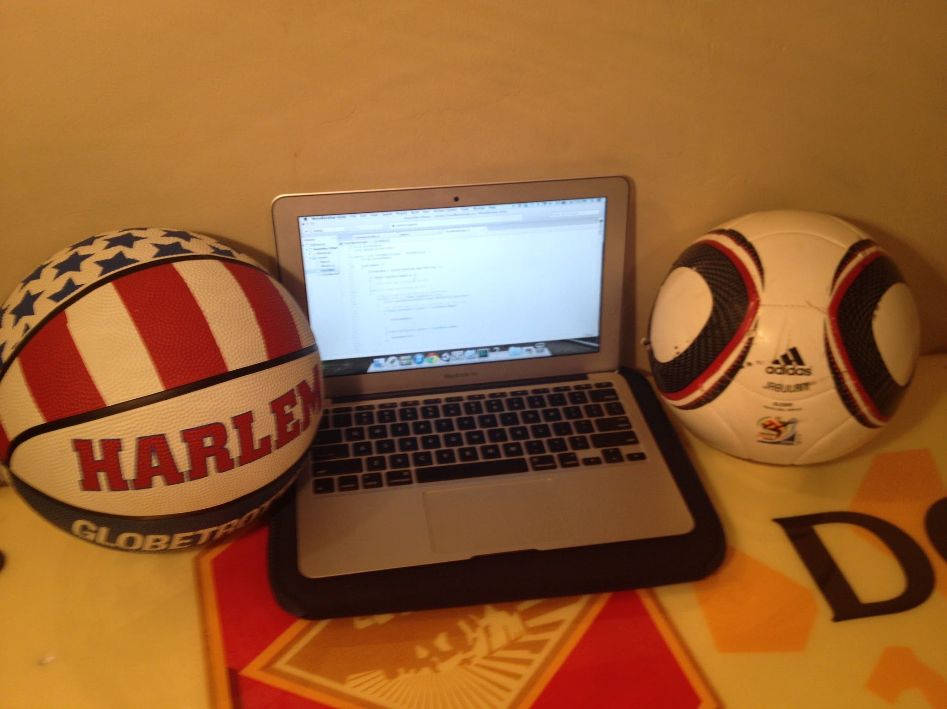
Who am I?
Student Athlete: AP Classes; Soccer & basketball
Amateur Programmer
Self - teacher: Technology evolves rapidly

Slide 5
Project Importance
Utilize and expand programming knowledge
Create a useful product
Career Exploration

Slide 6

What is the DigiGenda?
The product of the project
Organizational tool
Agenda alternative/ supplement
Notes:
define that DigiGenda is the name of your app

Slide 7
Global Context and Exploration
Context: Scientific Exploration and Innovation
Exploration: Products, processes, and solutions
Product: iPad app
Process: App development
Solution to: Student organization

Slide 8
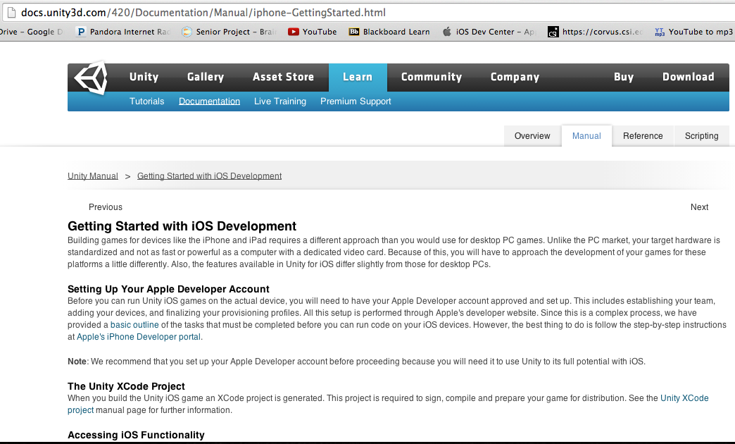
Step 1: Research and Acquire Tools
Research
Unity’s “Getting Started with iOS Development”
Tools
Unity 3D
MonoDevelop
Xcode
GIMP

Slide 9
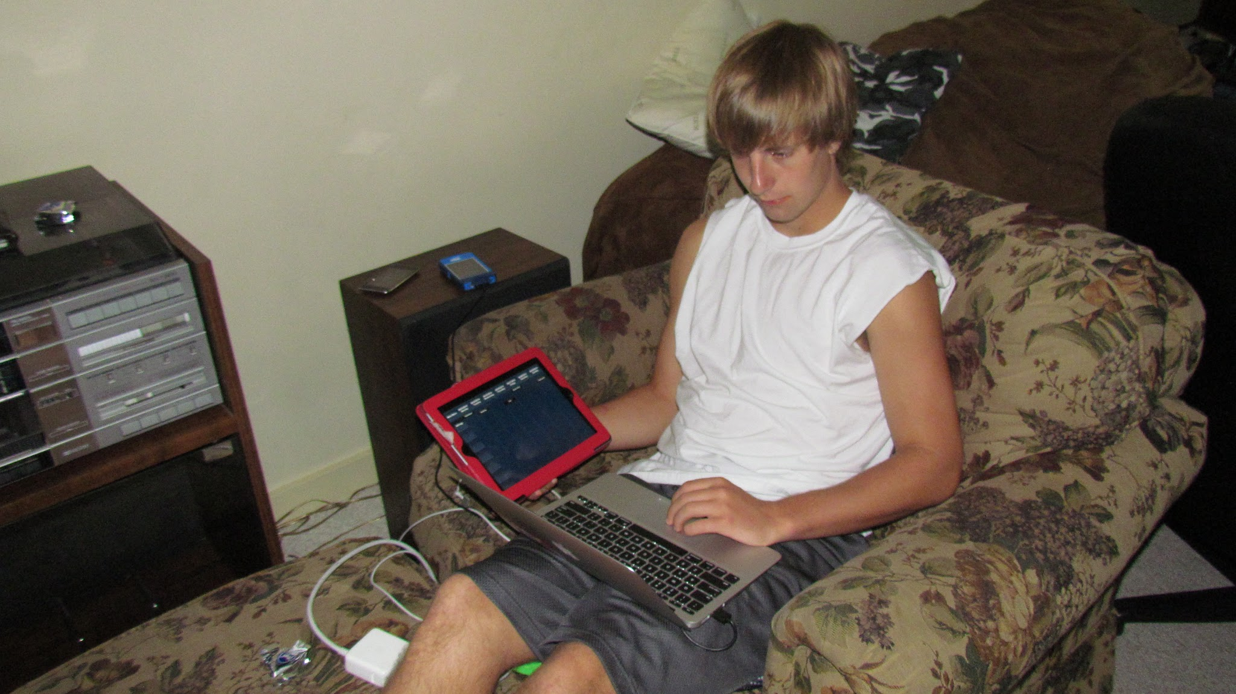
Step 2: Research iOS Development
Five Steps (continued on next slide)
1. Set-up the development environment

Slide 10
Step 2: Research iOS Development
Project Steps (Continued)
2. Create product outline
3. Execute plan and develop
4. Test the product and revise
5. Release and distribute the product

Slide 11




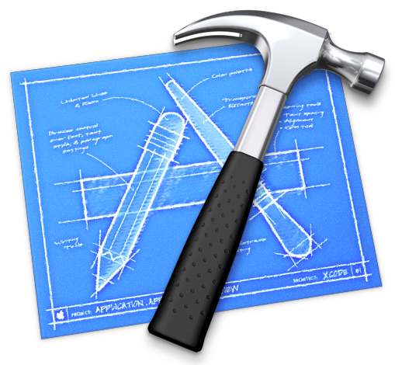

Step 3: Learn to use Software

Slide 12
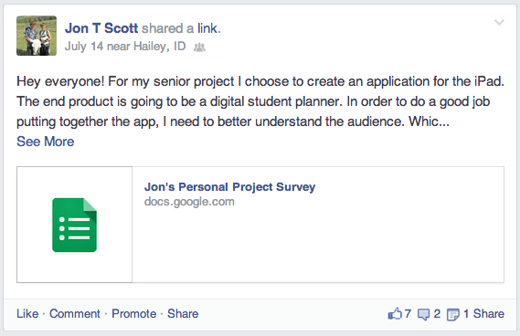
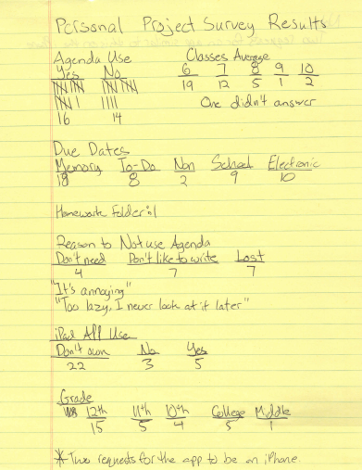
Step 4: Agenda and Organization Survey

Slide 13
Step 4: Important Results

Slide 14
Step 5: Research Good Behaviors
Color Coding
Week to week planning
Personal routine
Student planners (Agendas)
Organization is a process: always improving
Sources: Blogs, self-help and parental organization websites, personal experience

Slide 15
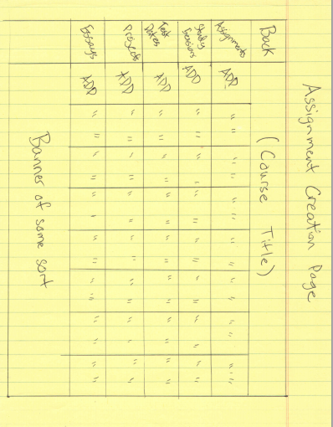
Step 6: Create App Outline

Slide 16
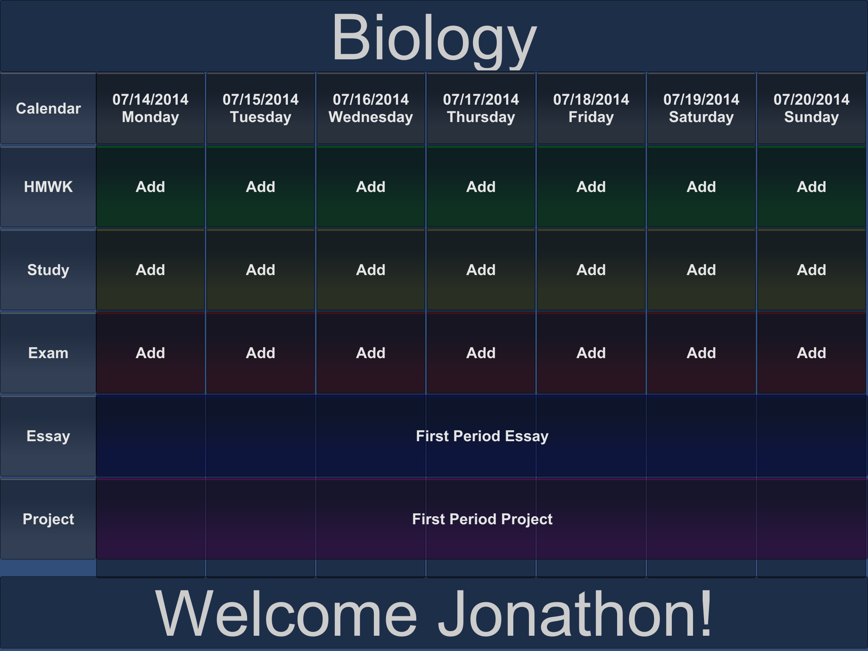

Slide 17
Step 7: Develop Application
Around 20,000 lines of code
Issues
Scaling difficulties (fonts, buttons, boxes)
Slow programs & crashing software
Organization of coding: Labeling data types and creation of multiple smaller scripts

Slide 18
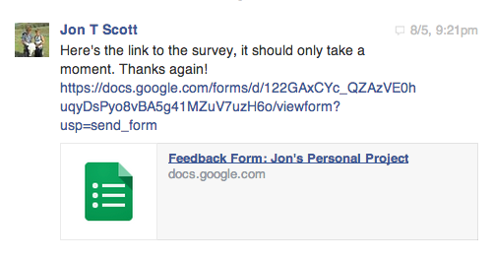
Step 8: Receive Feedback & Improve
Improvement: iPhone Version

Slide 19
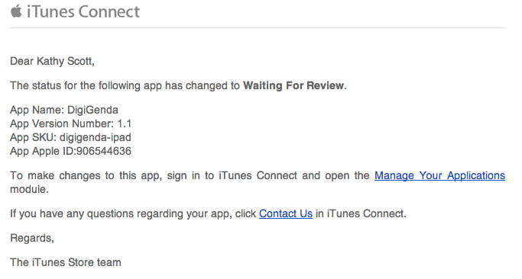
Step 9: Submit to App Store

Slide 20
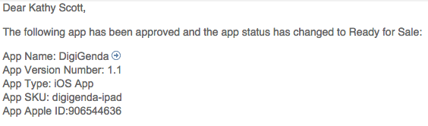
Seven days later...
Success!!

Slide 21

Reflection
Strengths: Determination, problem solving
Weaknesses: Inexperience, impatience
Future Plans
Computer Science in college
New apps, games and tools
Notes:
Think of product, processes, and solutions in terms of app development as well as agenda use.
Also, tie to future plans.

Slide 22

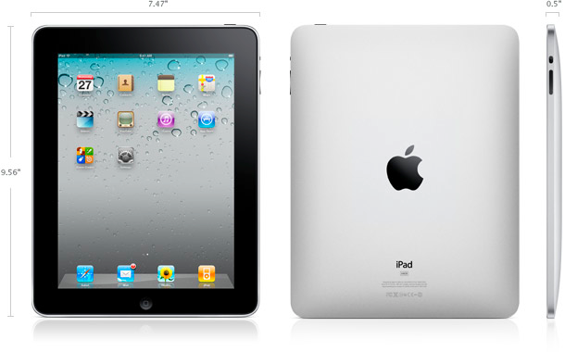
Context Learning
Product: iPad App
Process: App development
Solution: Anything
Product: DigiGenda
Process: Organization
Solution: Time management
Notes:
Think of product, processes, and solutions in terms of app development as well as agenda use.

Slide 23


What about the Project Question?
To refresh, the question is, “How can an organizational application improve a student’s time management skills?”

Slide 24

People with good time management...
Don’t Panic
Stress Less

Slide 25

Answer… Based off step 5 research
Establish routine: daily expectations
Reduce stress: less unwelcome surprises
Allow more time for extracurricular activities
Personal Answer
Daily satisfaction

Slide 26
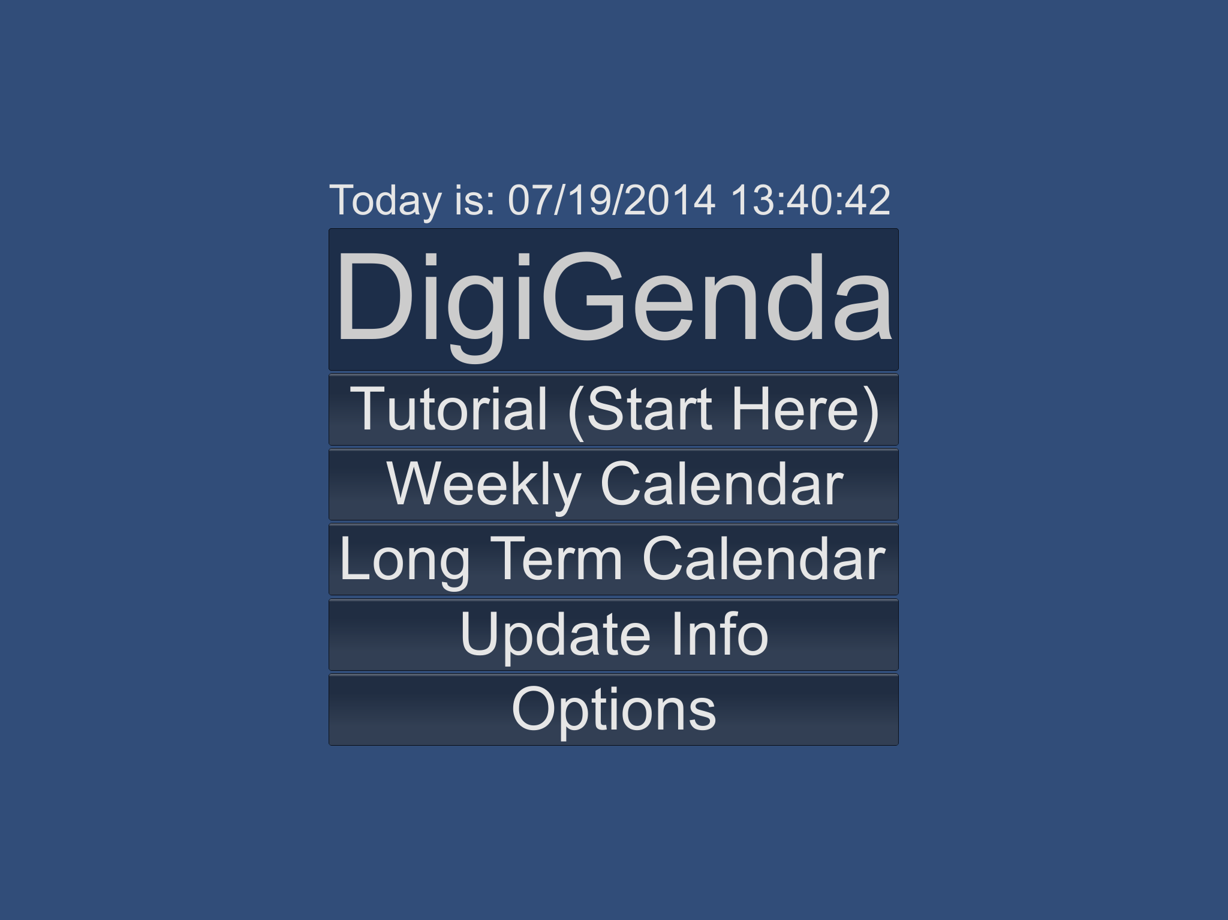
Thank you for your time!
Questions
Product Demonstration

